Slide 1
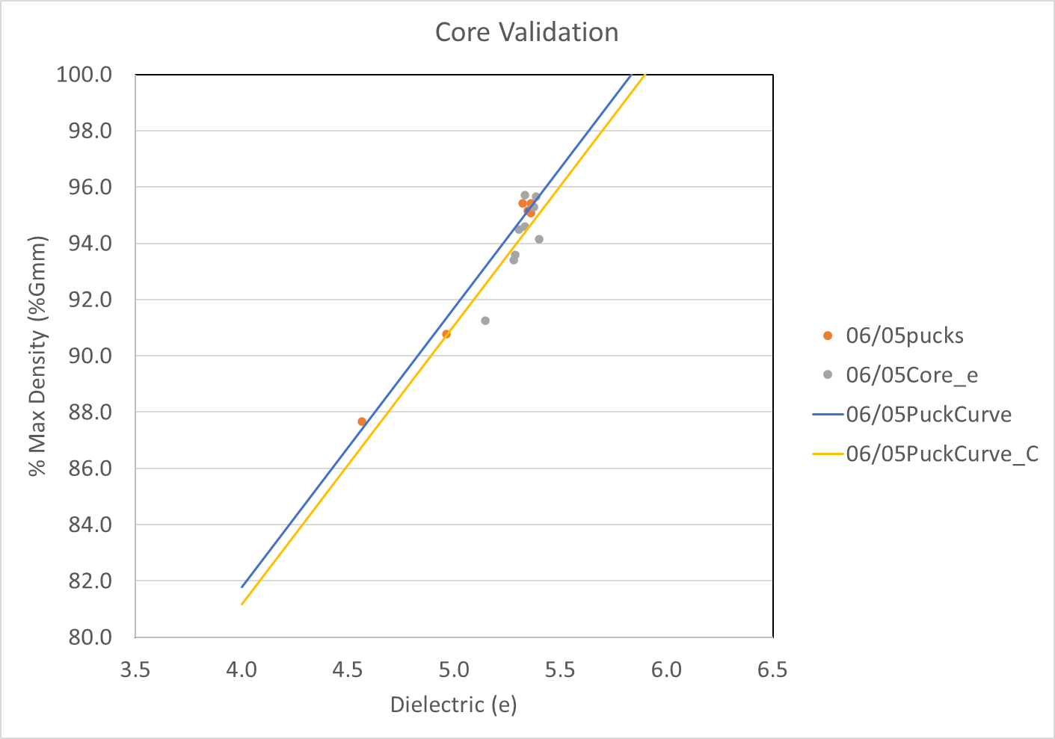
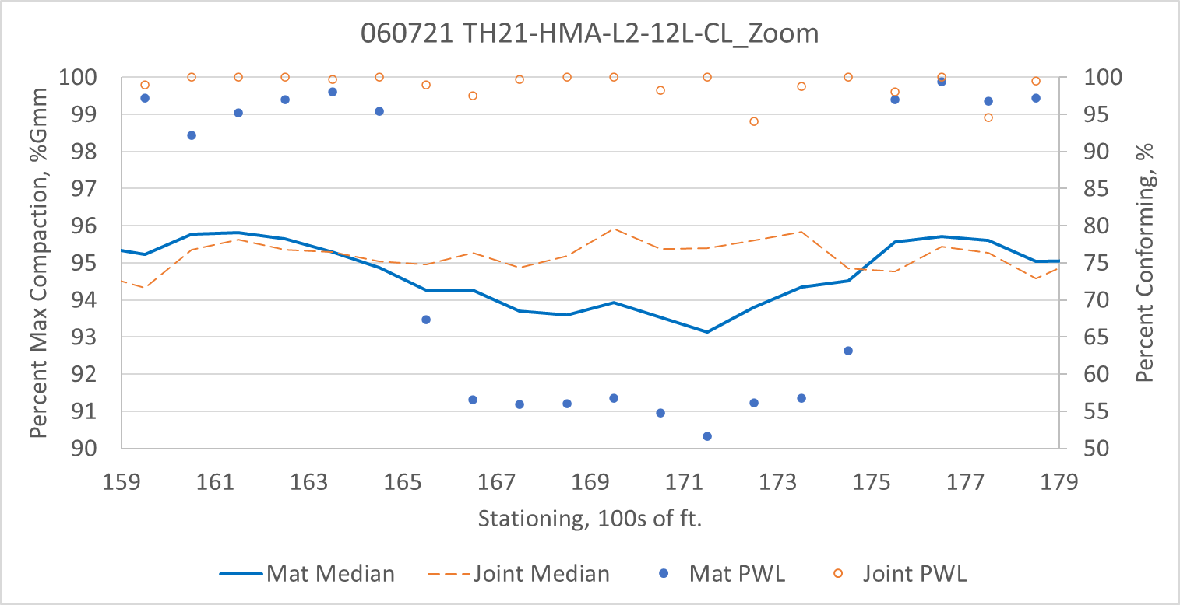
MnDOT Data Collection and Analysis
Kyle Hoegh
Mercedes Maupin
Shongtao Dai

Slide 2
MnDOT Analysis: 2021 Collection Season
Hired 2 contractors to collect according to data specification
  Mathy: Pay by the section with a DPS cart they own (needed to borrow our puck kit and GPS equipment)
  Ulland: Pay be the project with minimum acceptable coverage using rental DPS (needed to borrow our GPS equipment initially, and at times throughout the season
4 Projects (TH21 – 13 days, TH 60 (2 projects – 27 days, TH 30 – 6 days)
  Last year: 6 Projects with puck fabrication (251, 2, 30, 95, 25, MnROAD)
46 production days with Core Accuracy Checks
  Last year: 30 unique production days
> 300 pucks fabricated and tested
  Last year: 78 pucks fabricated and tested
> 600 dielectric tests
  Last year: 234 dielectric tests

Slide 3
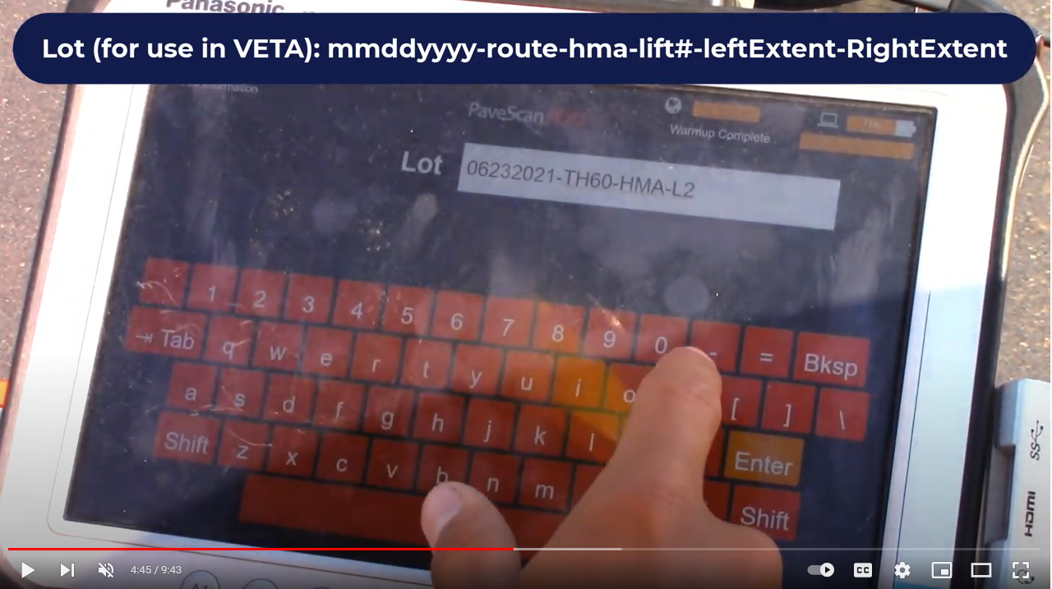
Data Consistency Check
On-Site Result: Swerve
https://youtu.be/A3j870wC2dA?t=285

Slide 4
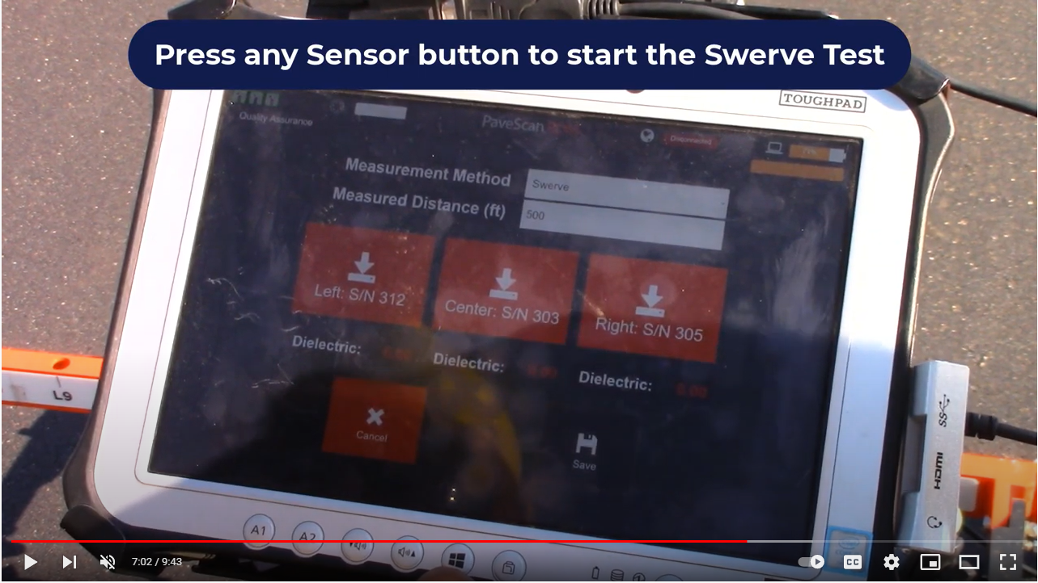
Data Consistency Check
On-Site Result: Swerve
https://youtu.be/A3j870wC2dA?t=422

Slide 5
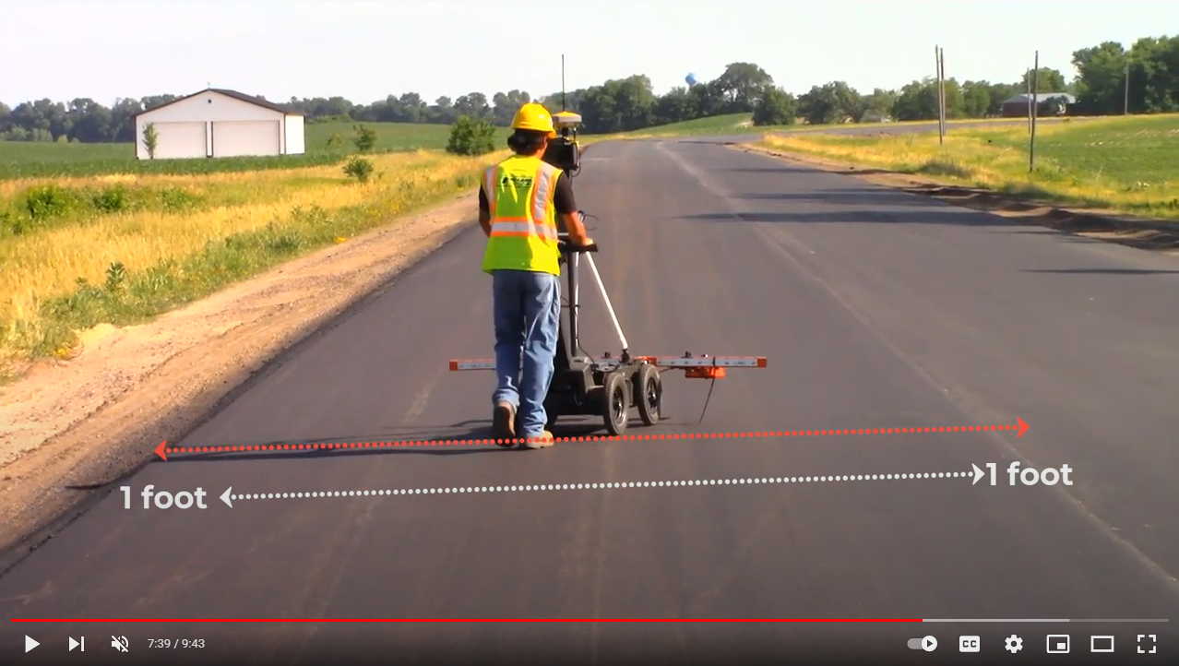
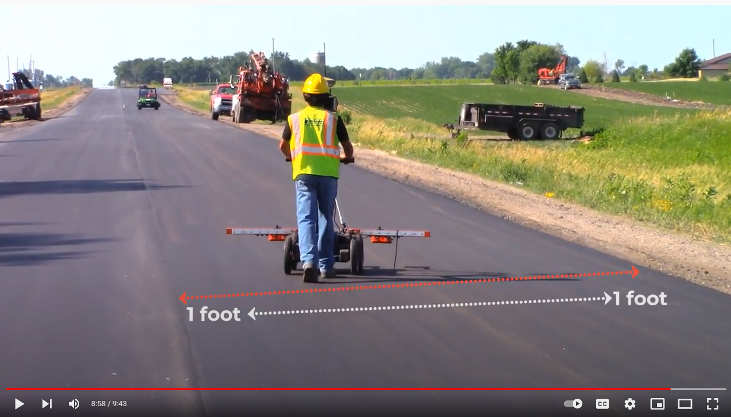
Data Consistency Check
On-Site Result: Swerve
Pass Forward
Pass Back
https://youtu.be/A3j870wC2dA?t=459

Slide 6
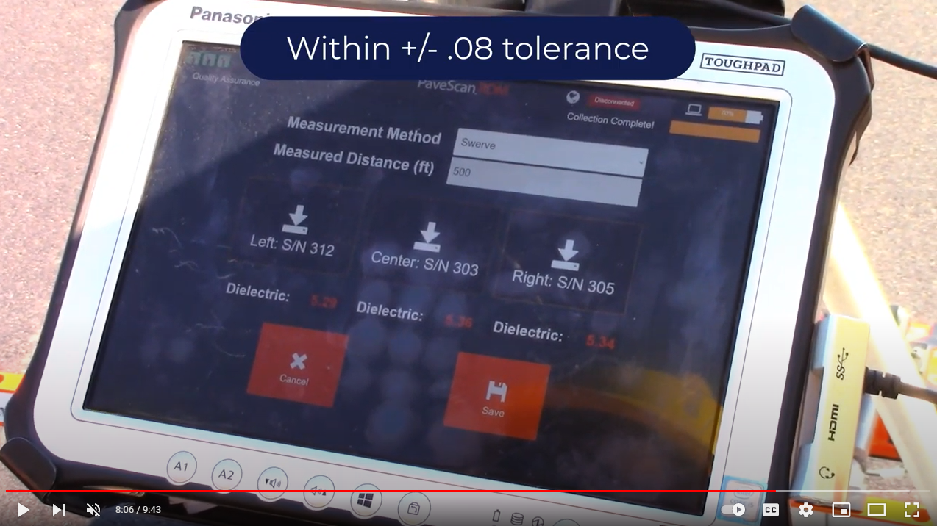
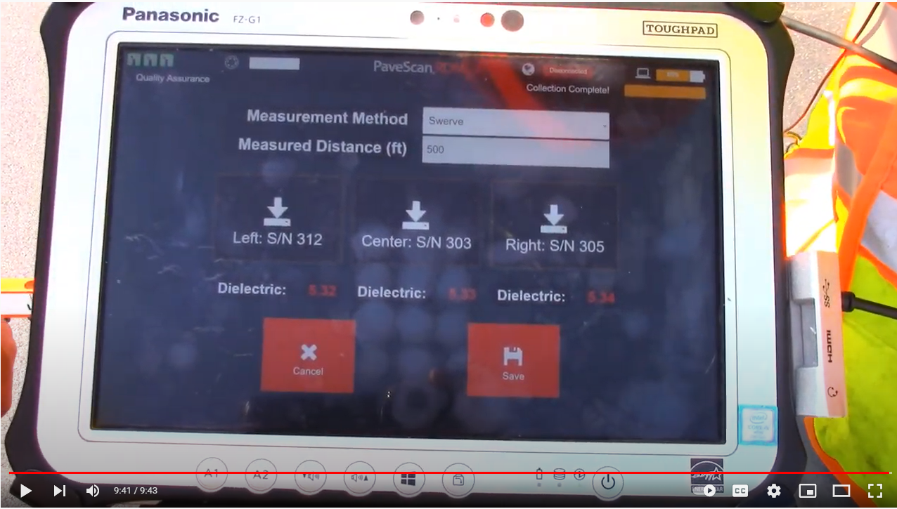
Data Consistency Check
On-Site Result: Swerve
Pass Forward
Pass Back
https://youtu.be/A3j870wC2dA?t=486

Slide 7
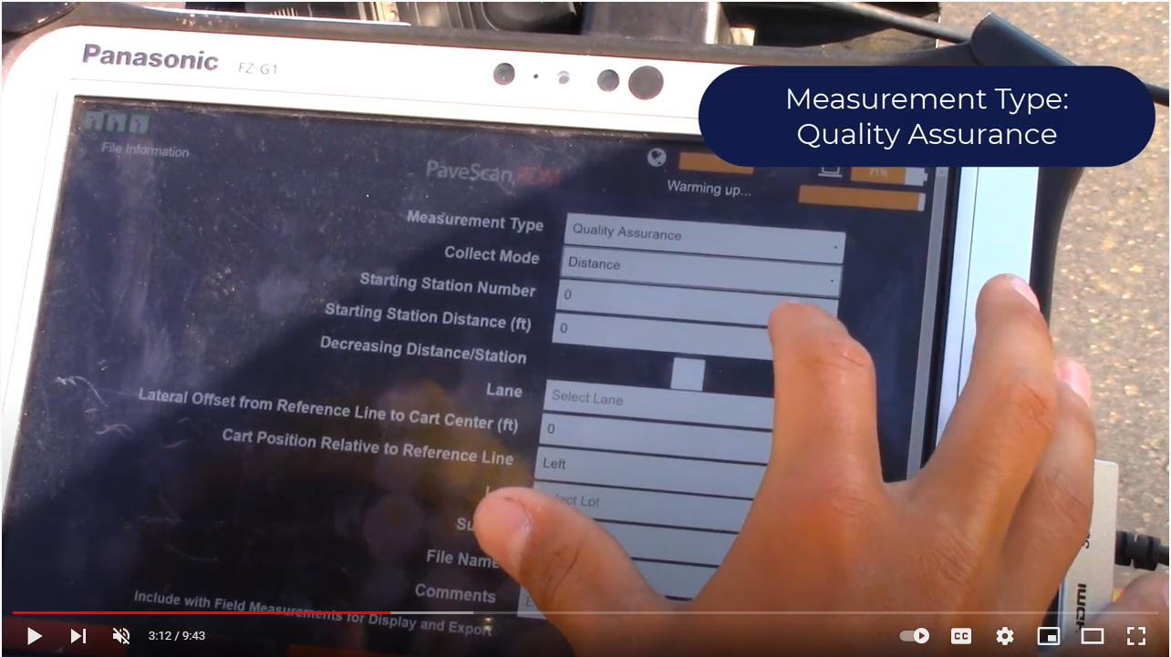
Data Consistency Check
On-Site Result: Line Test
https://youtu.be/A3j870wC2dA?t=192

Slide 8
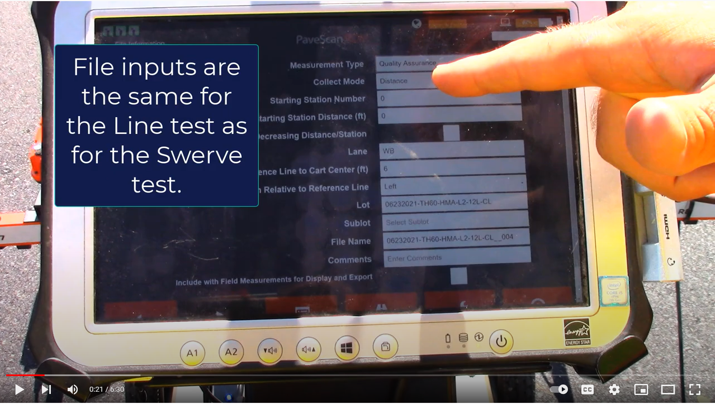
Data Consistency Check
On-Site Result: Line Test
https://youtu.be/BdLn62fxHRc?t=21

Slide 9
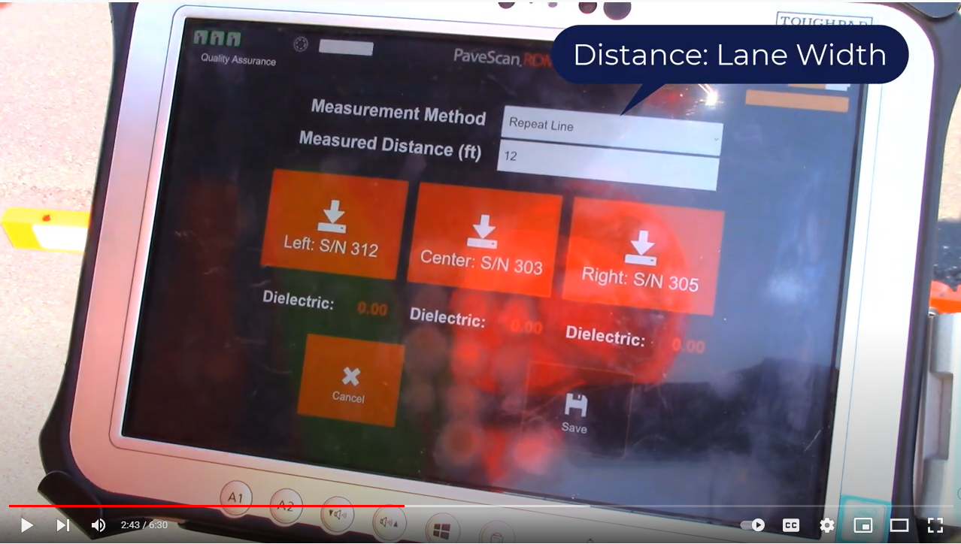
Data Consistency Check
On-Site Result: Line Test
https://youtu.be/BdLn62fxHRc?t=163

Slide 10
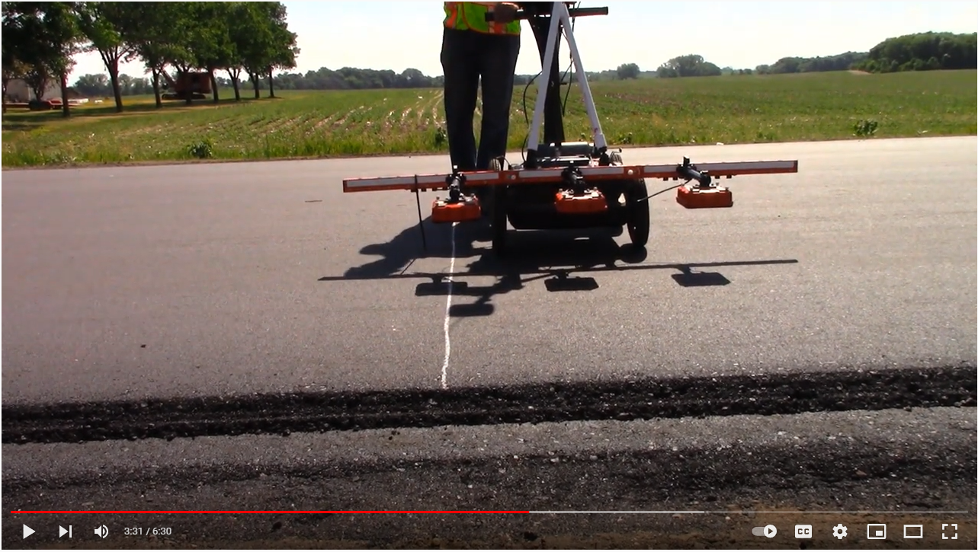
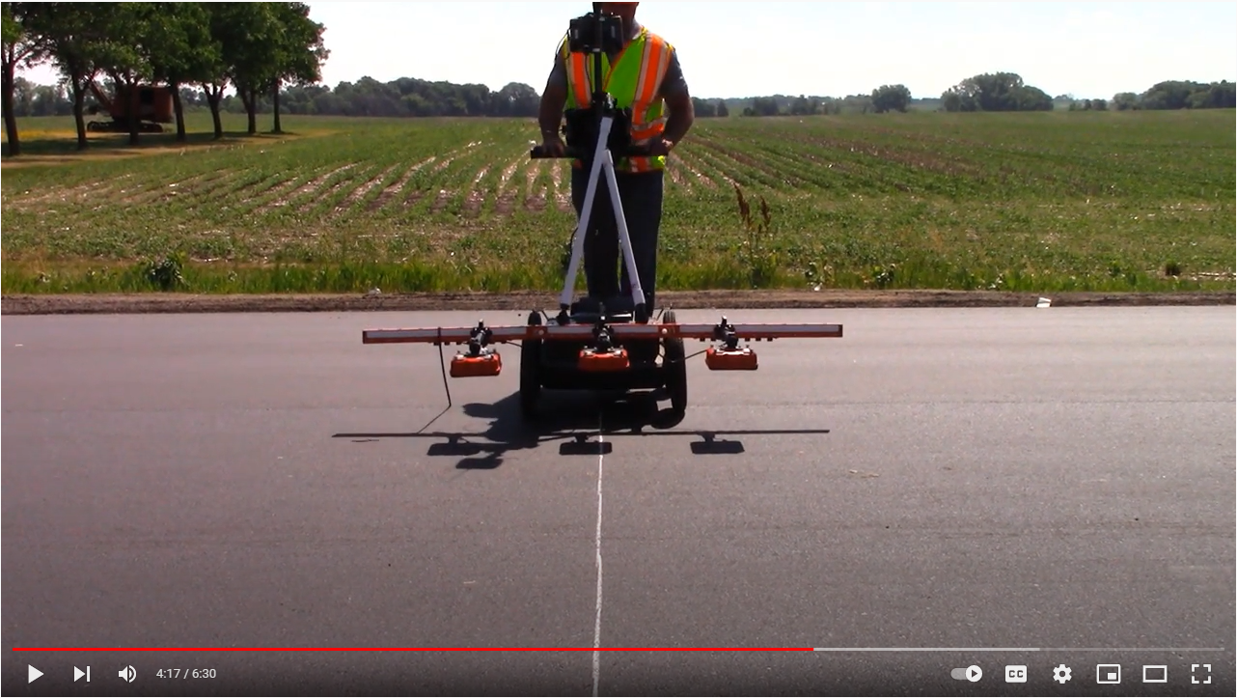
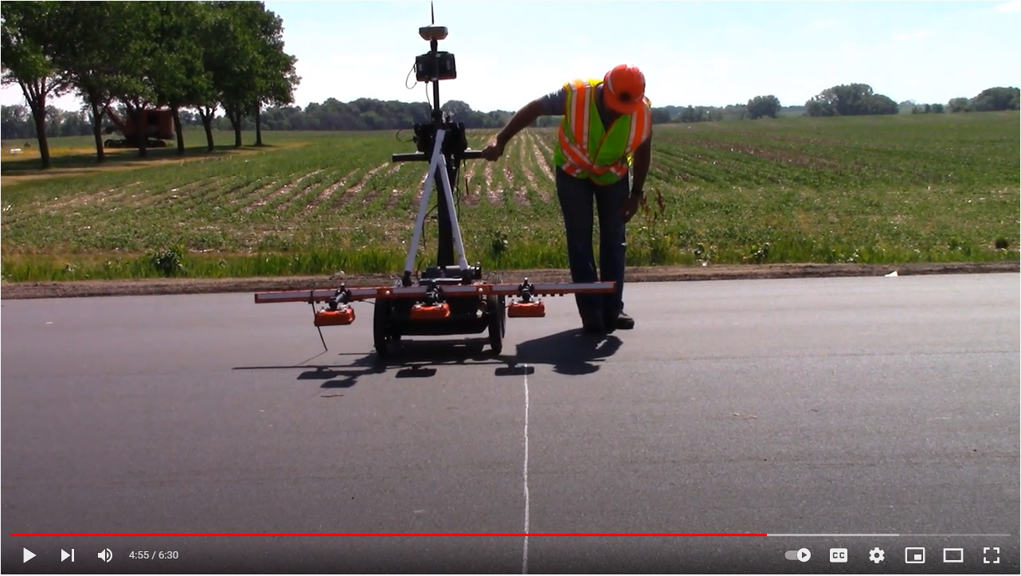
Data Consistency Check
On-Site Result: Line Test
Right Sensor
Center Sensor
Right Sensor
https://youtu.be/BdLn62fxHRc?t=295

Slide 11
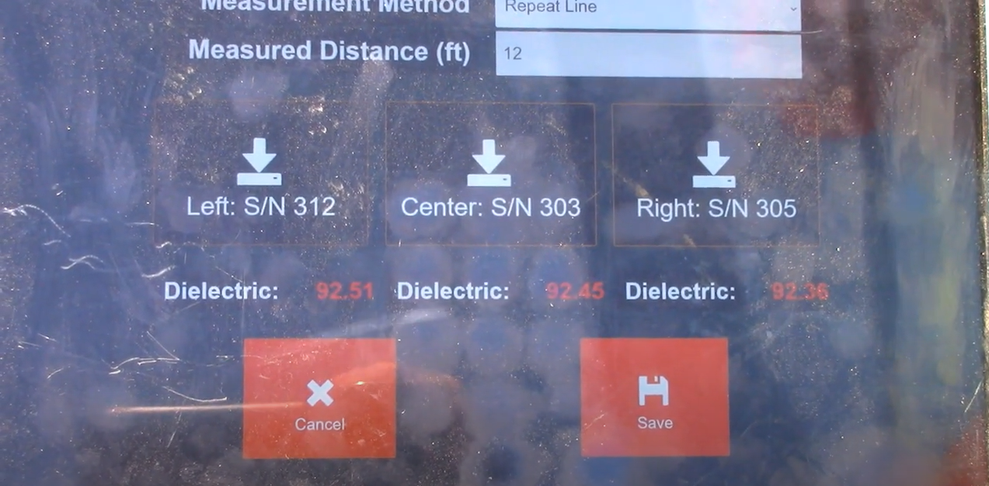
Data Consistency Check
On-Site Result: Line Test
https://youtu.be/BdLn62fxHRc?t=295
Density:
Density:

Slide 12
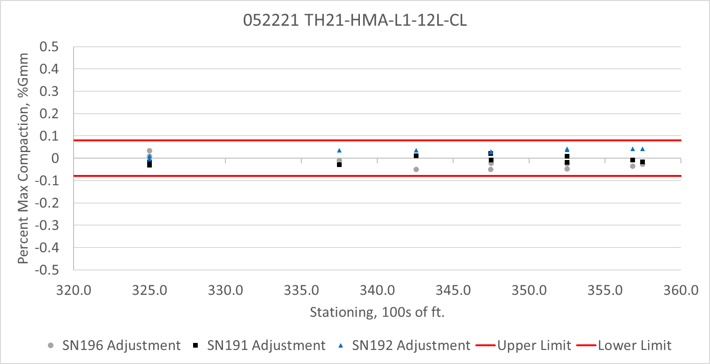
Data Consistency Check
Season Results: Continued last year’s trend of highly consistent sensors!
  Last Year: Little to no bias between sensors on average
    171:
      0.014 avg
      93% within 0.08
      78% within 0.05
    173:
      -0.006 avg
      96% within 0.08
      90% within 0.05
    181:
      -0.007 avg
      94% within 0.08
      81% within 0.05
  This year only required consistency check every 4000 ft. or 4 hours whatever comes first.

Slide 13
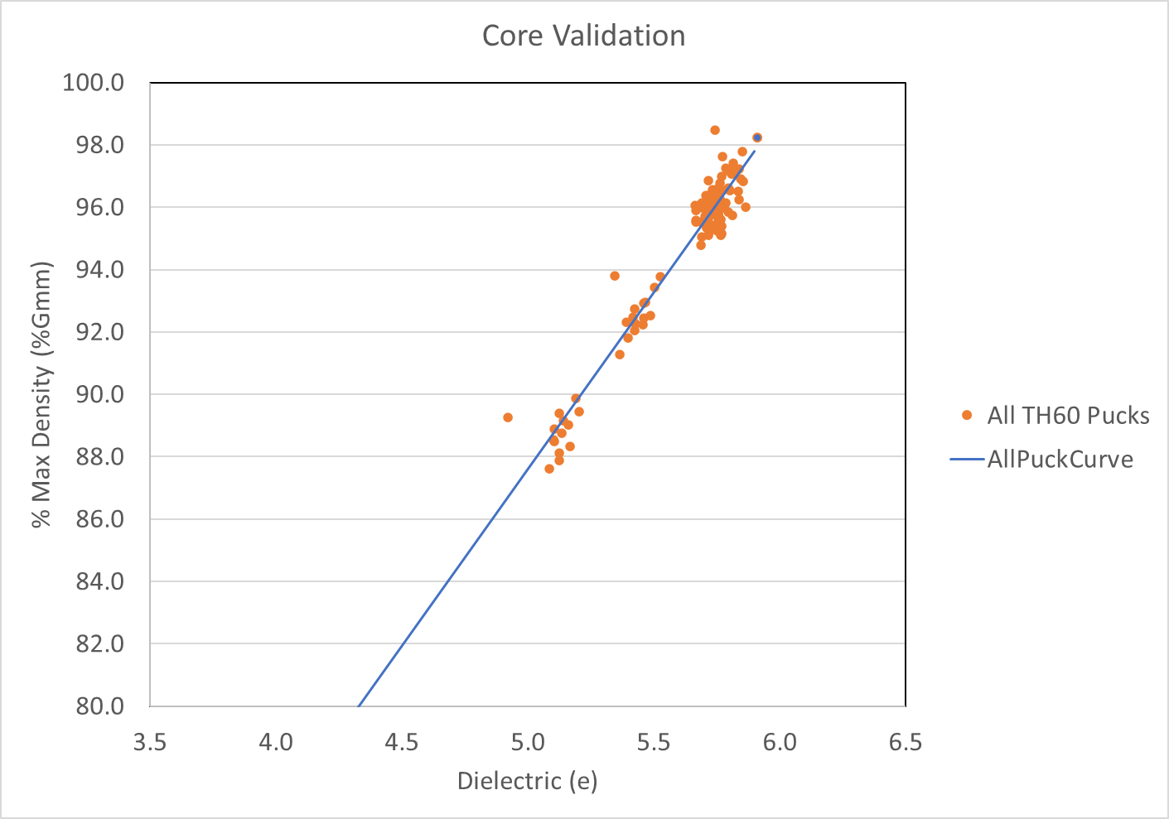
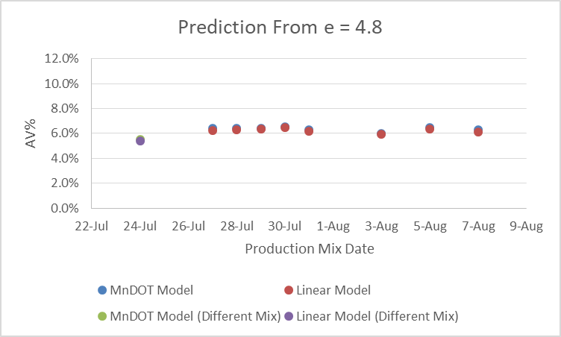
Dielectric to Density: Core Accuracy Check
Puck conversions continue to be very stable day to day
  Small day to day variation if no significant changes in mix
  Able to detect large mix changes
2021: TH 60 Example (>100 pucks)
2020: TH2 Example
mndot.gov

Slide 14
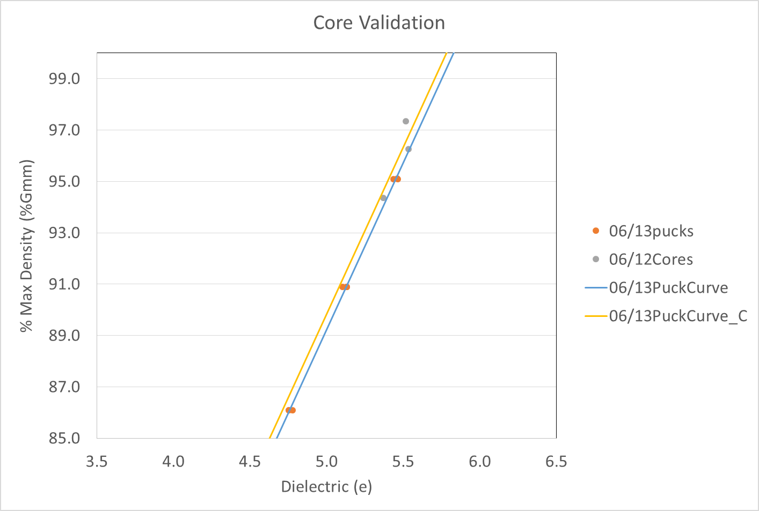
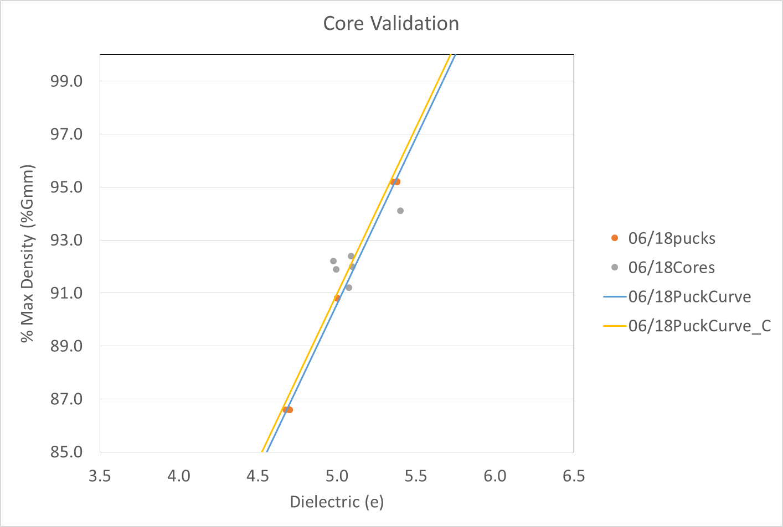
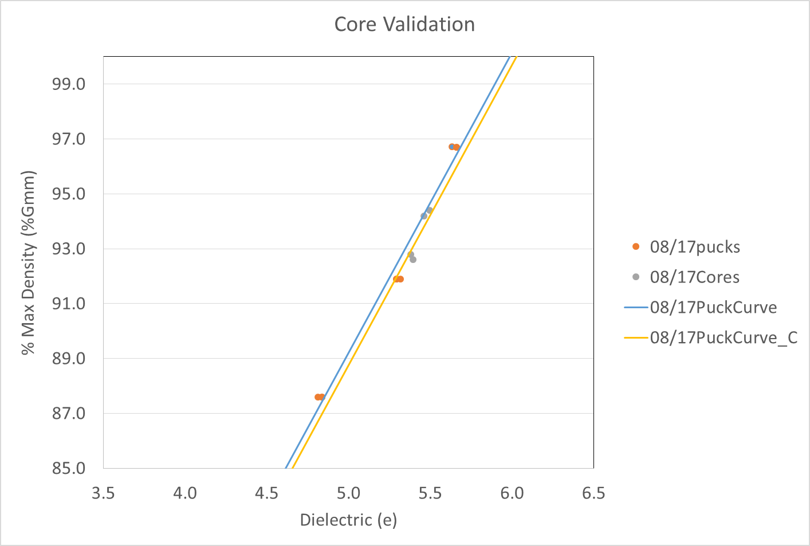
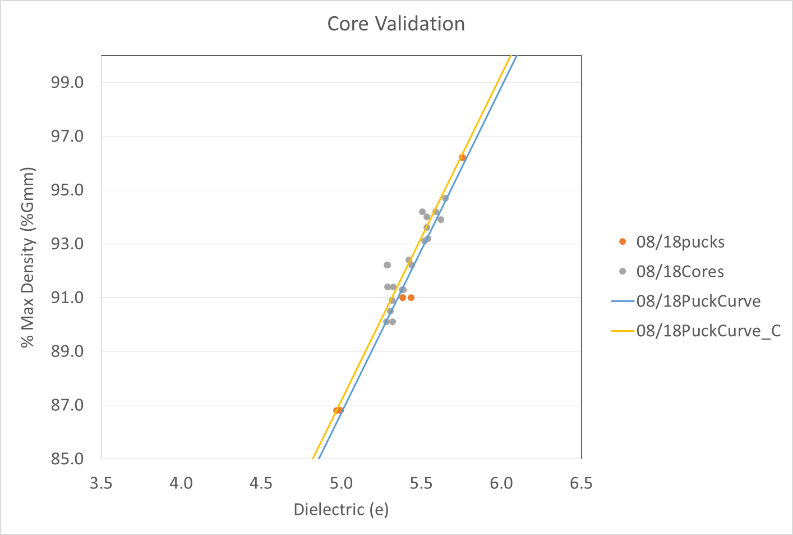
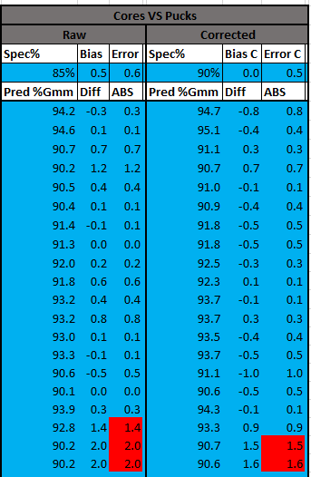
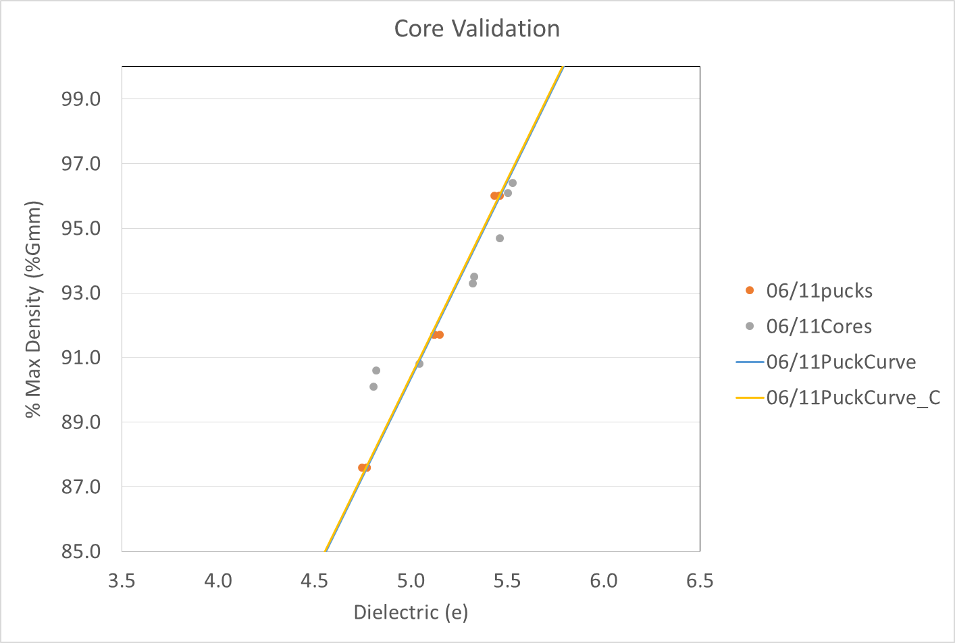
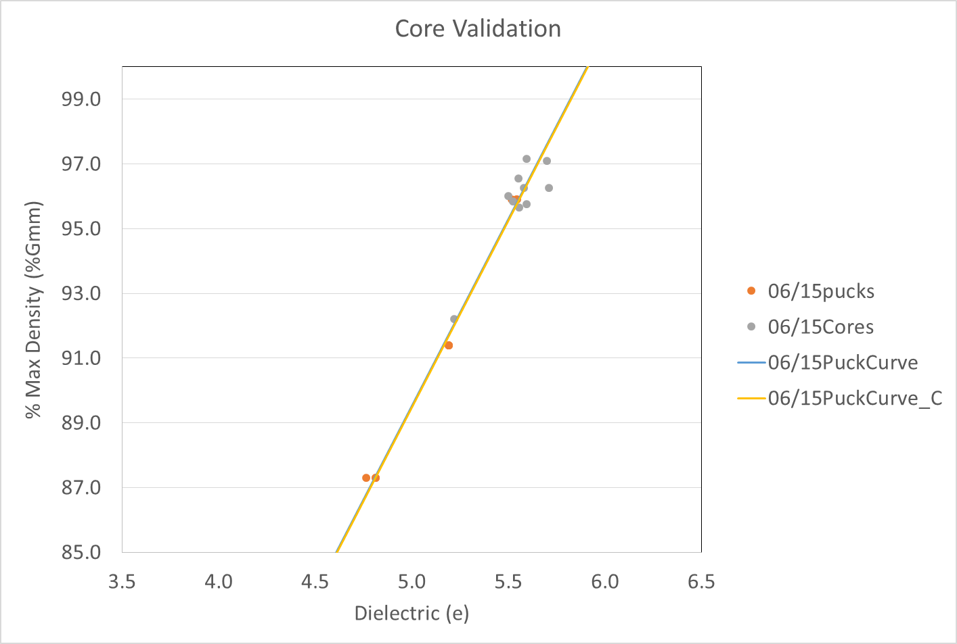
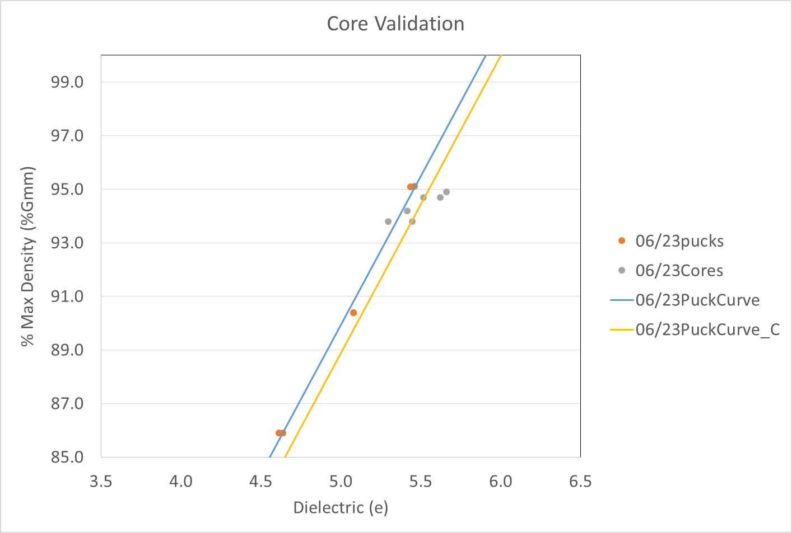
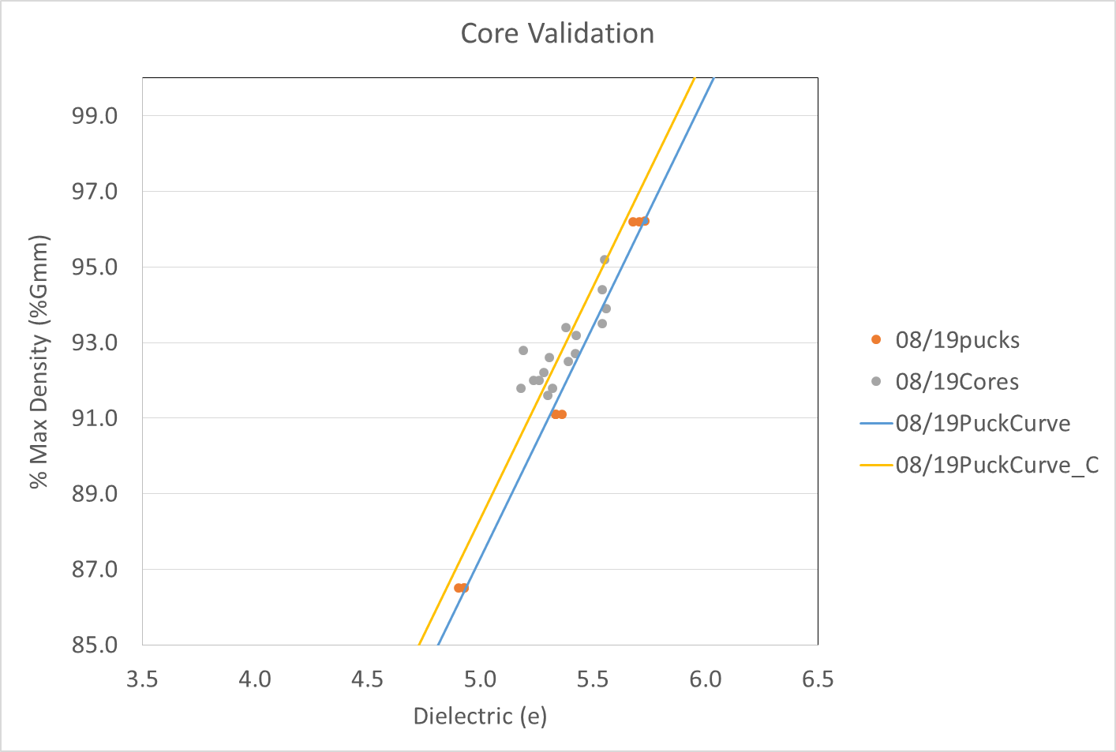
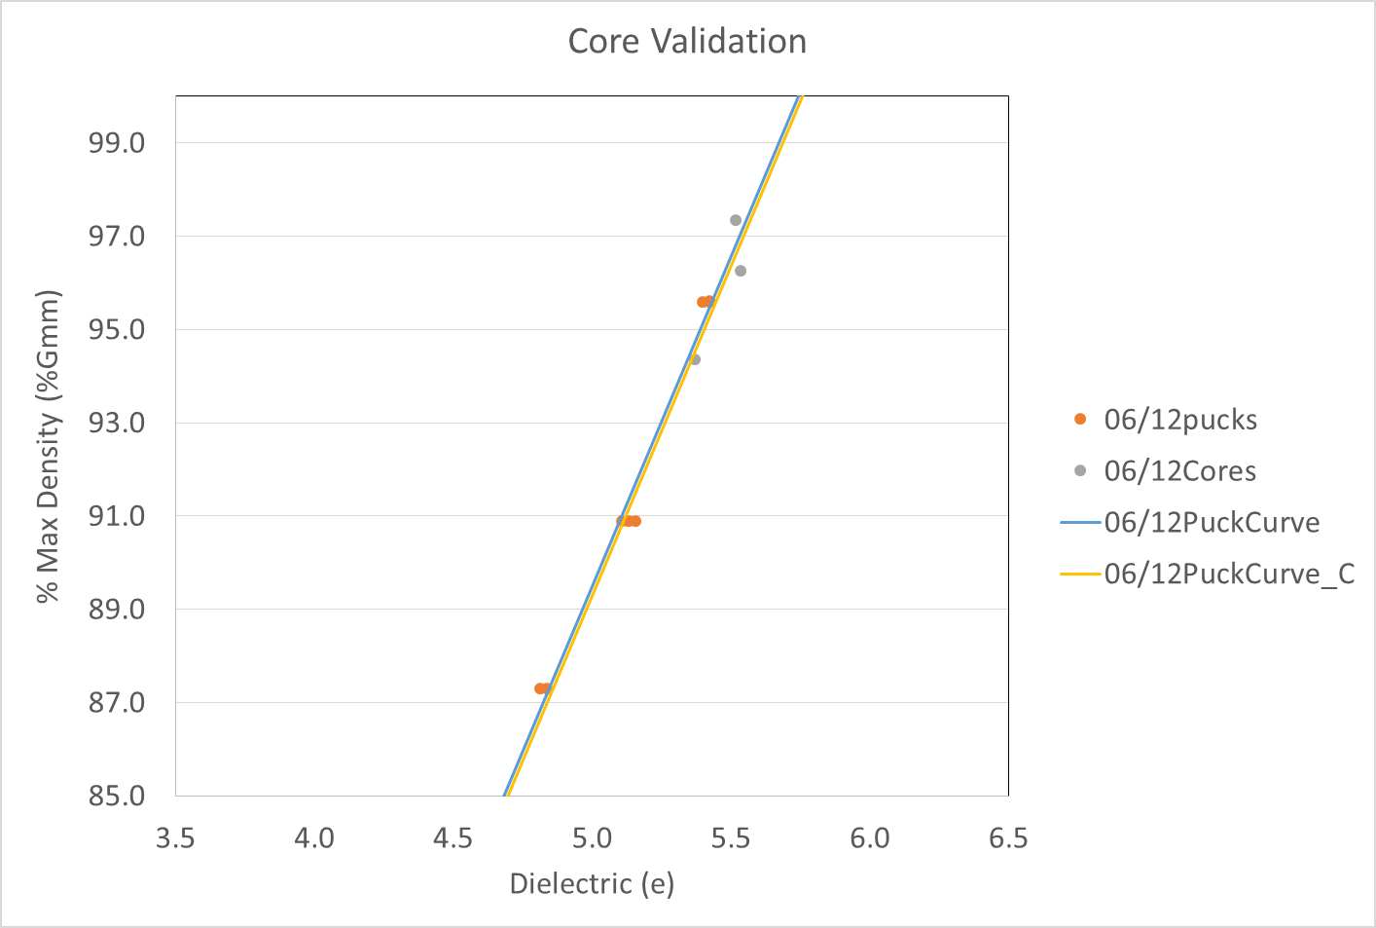
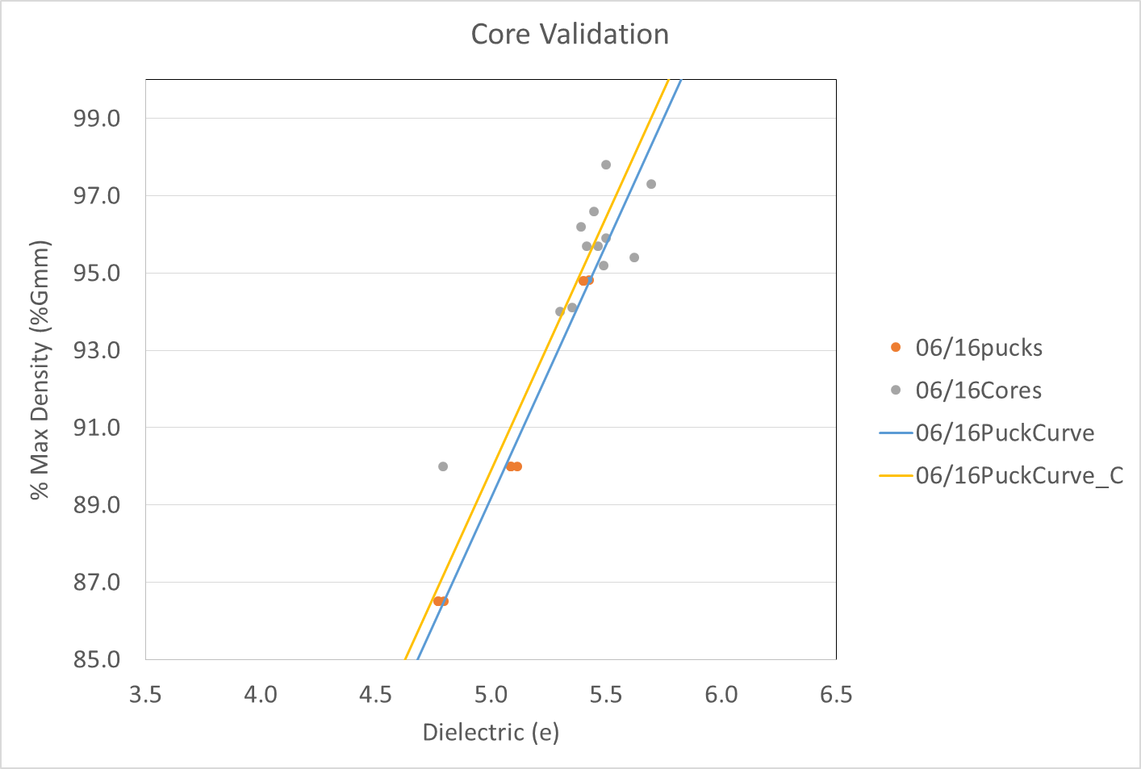
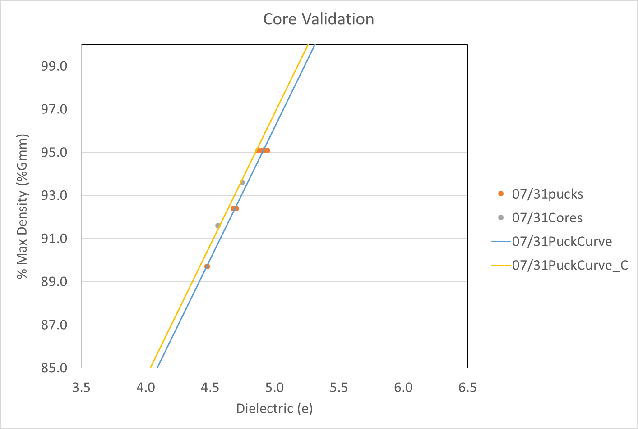
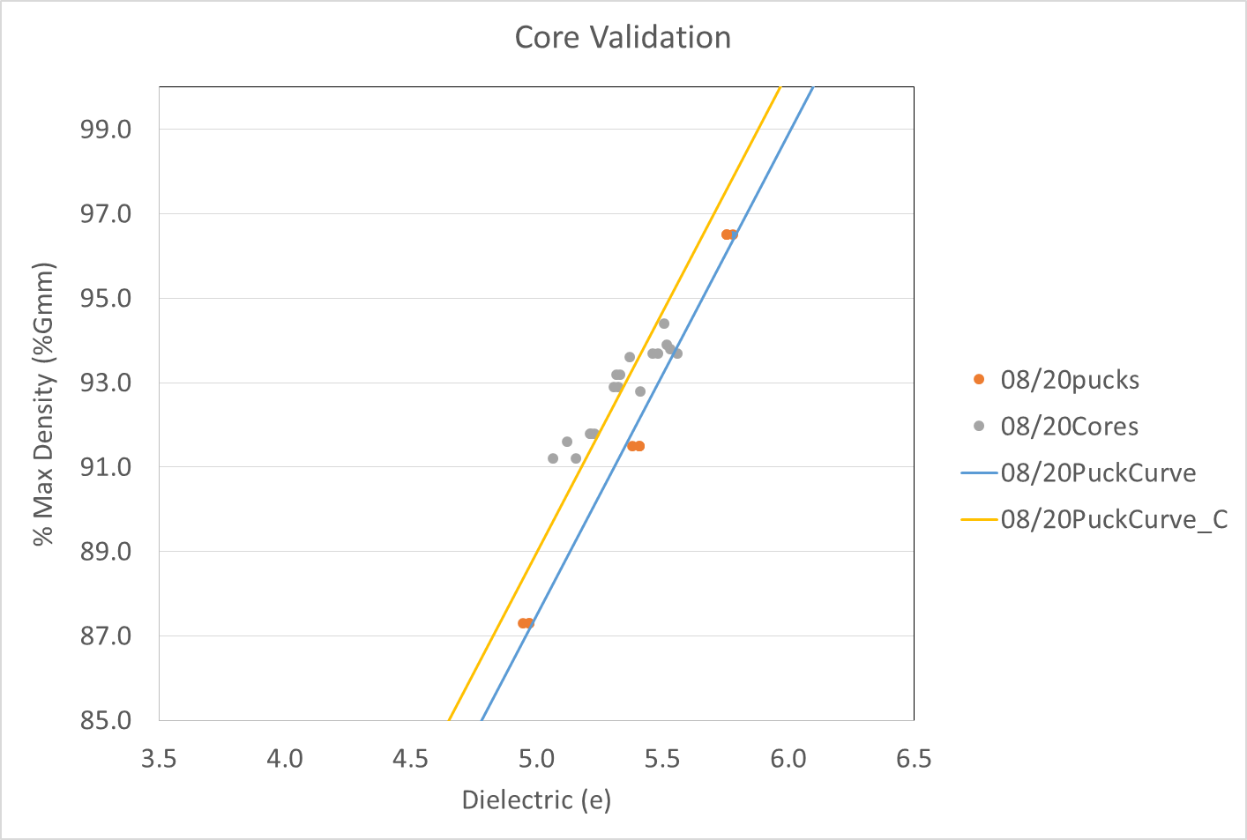
2020 Dielectric to Density: Core Accuracy Check
Mostly reasonable agreement

Slide 15
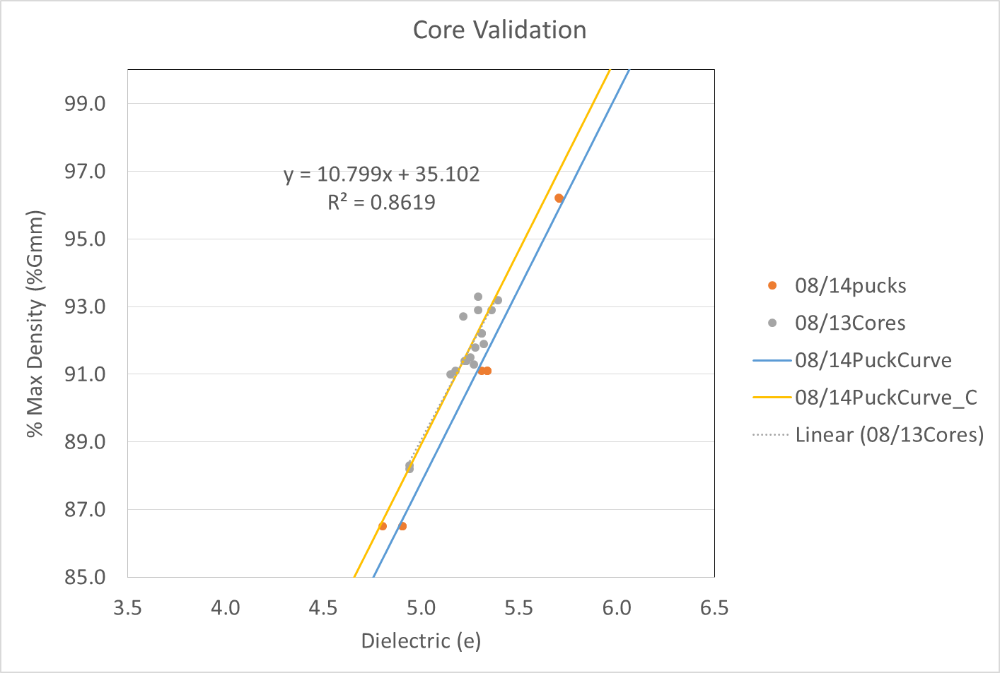
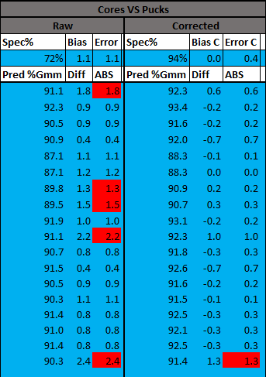
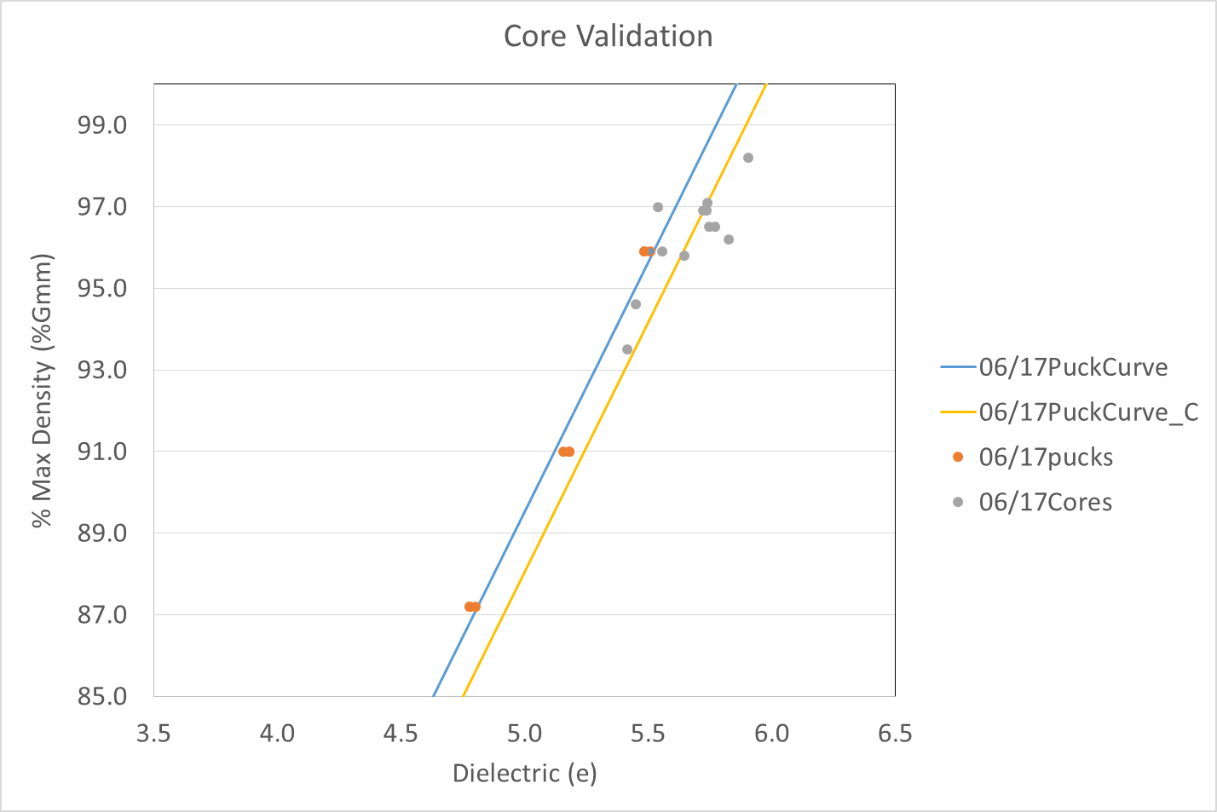
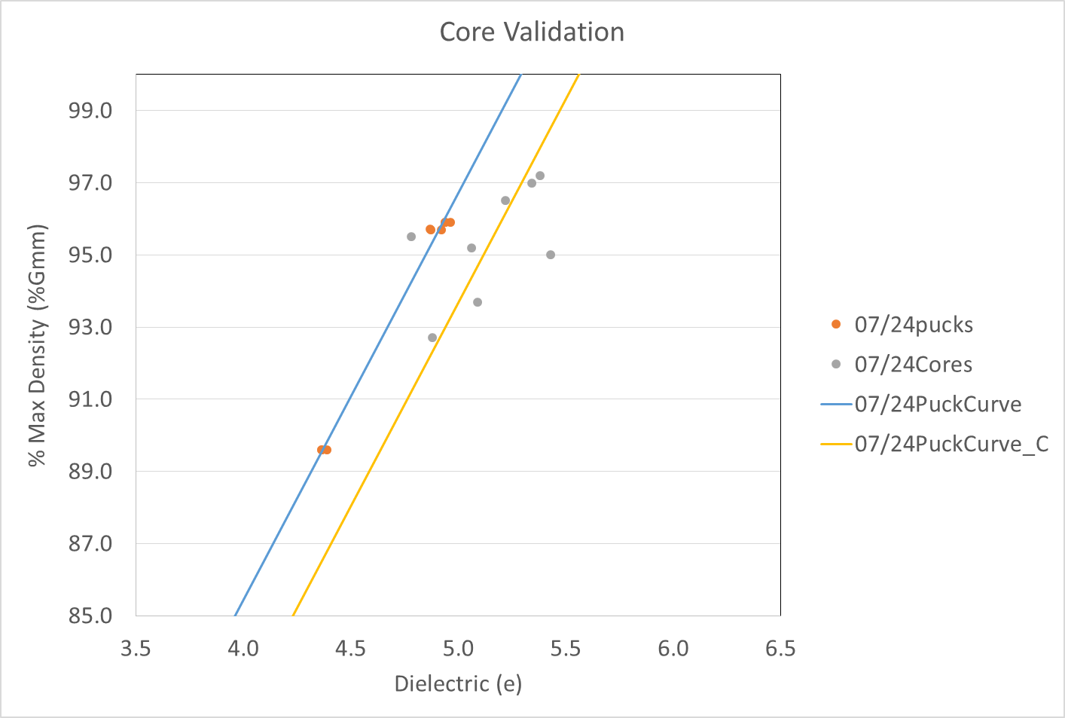
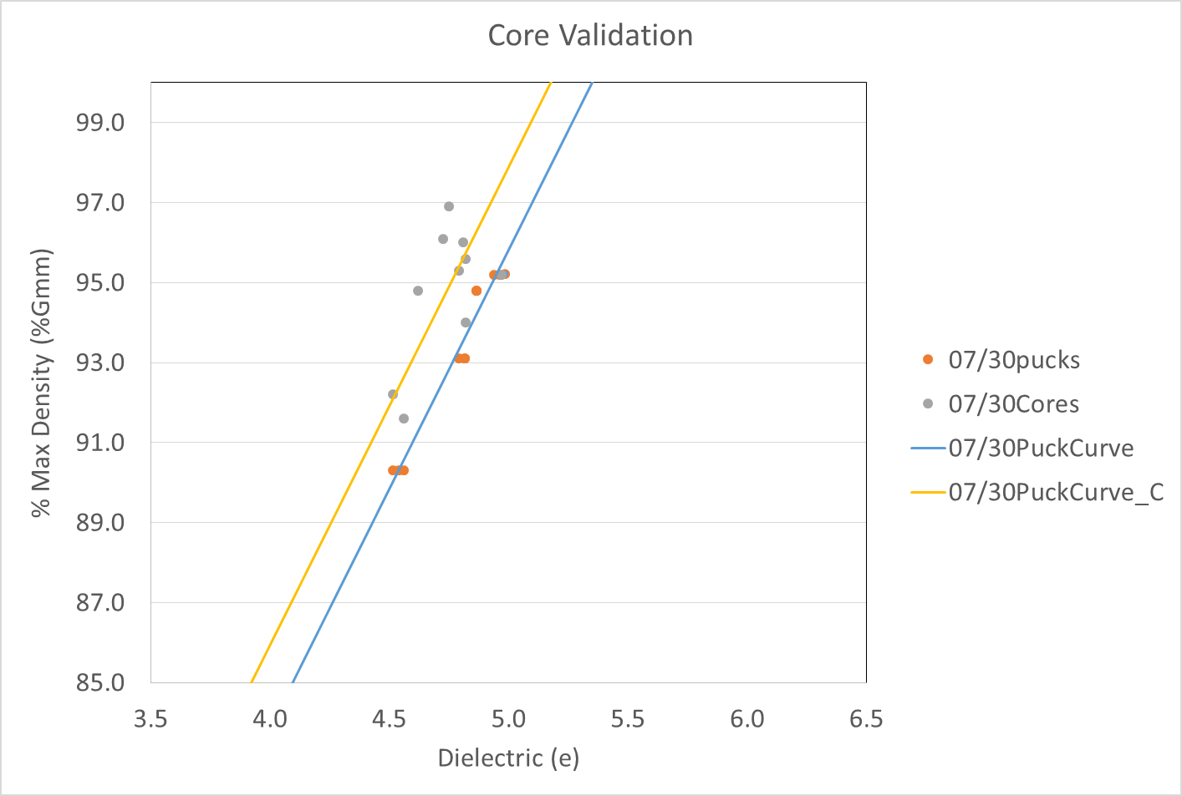
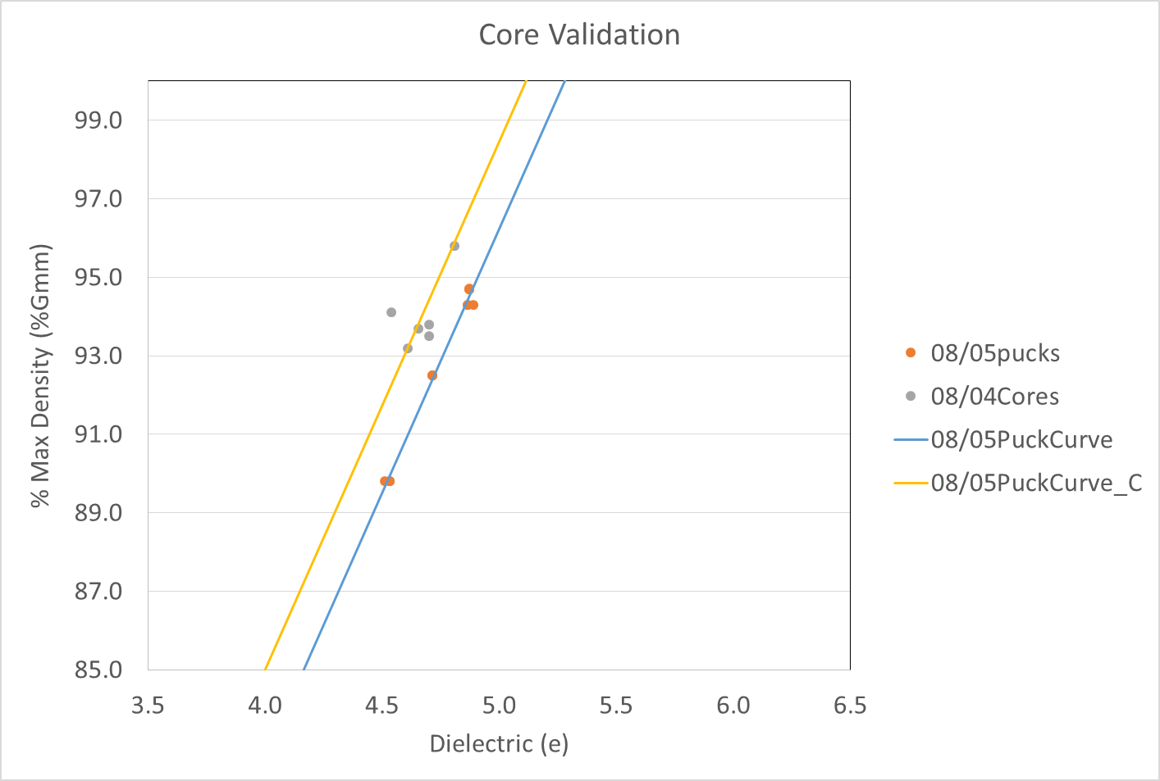
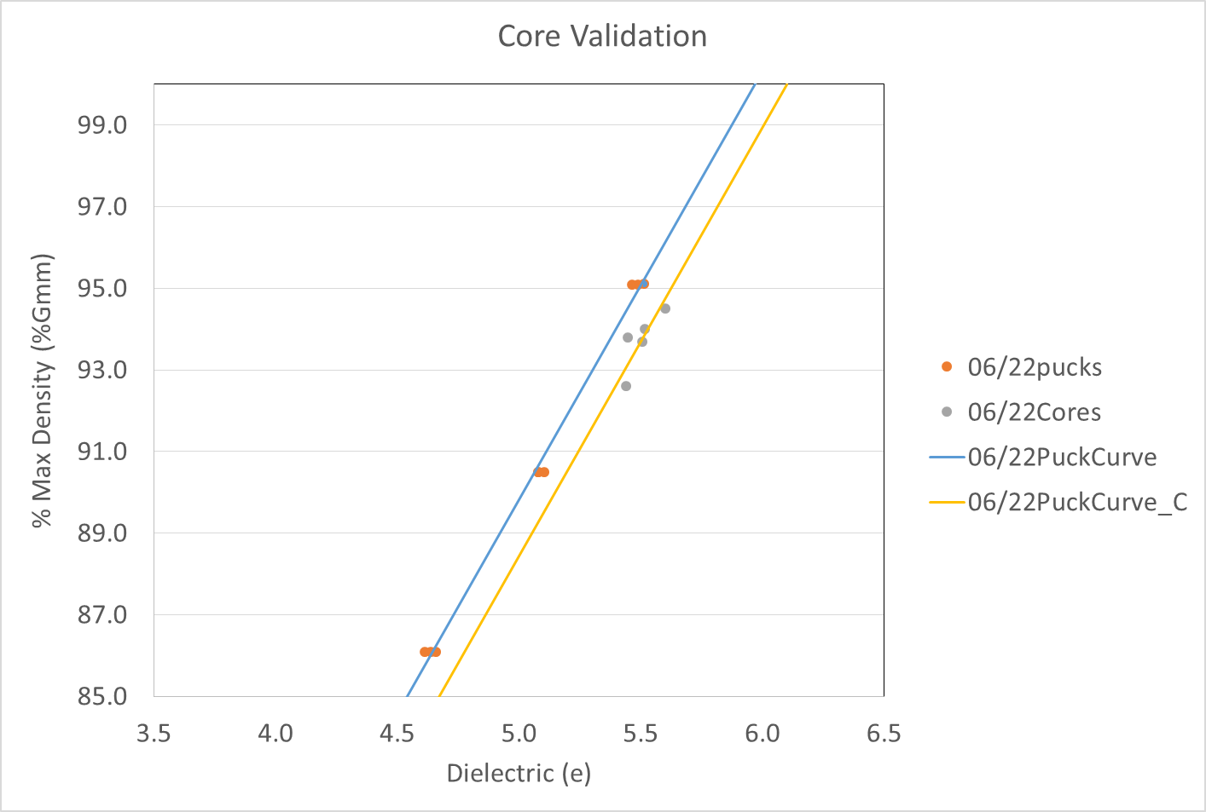
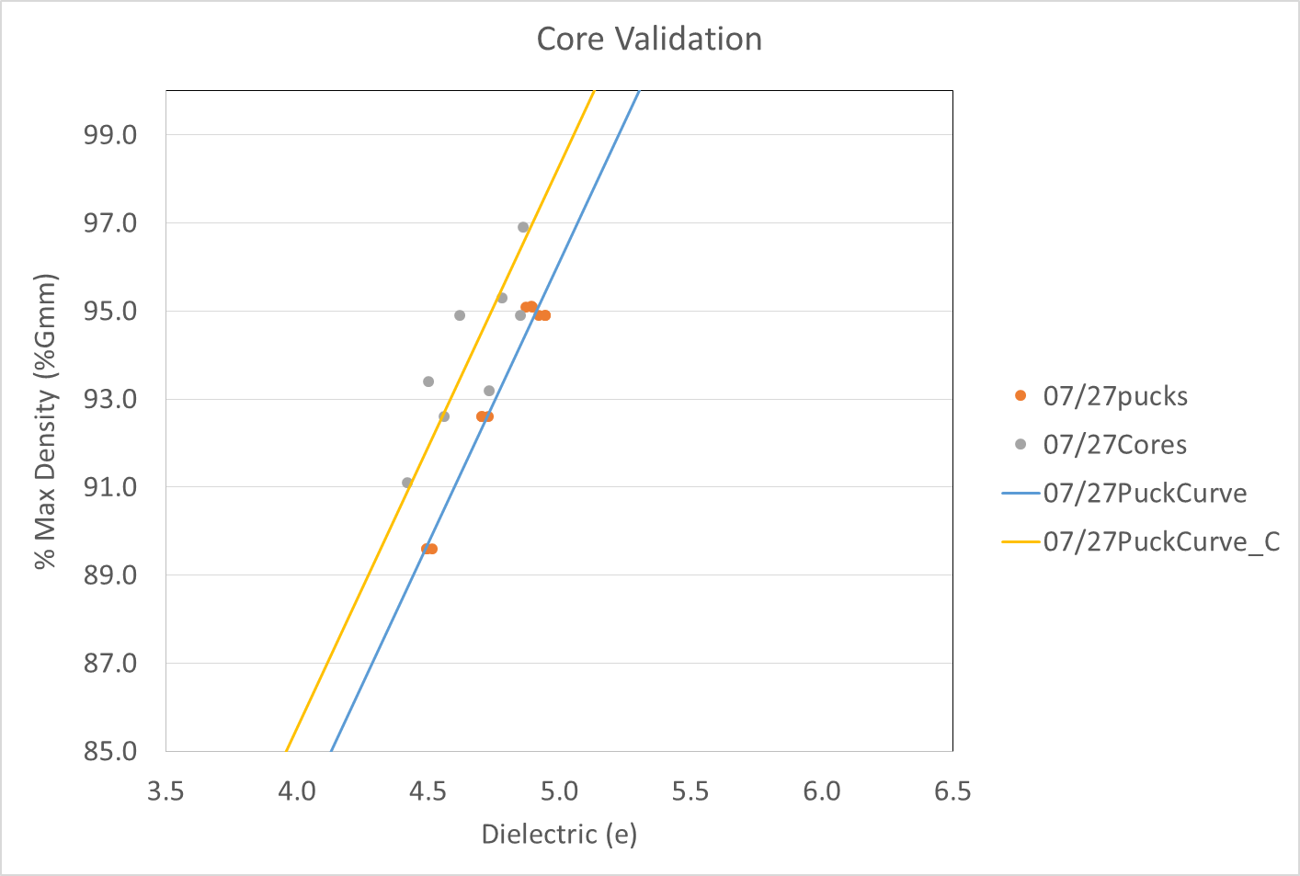
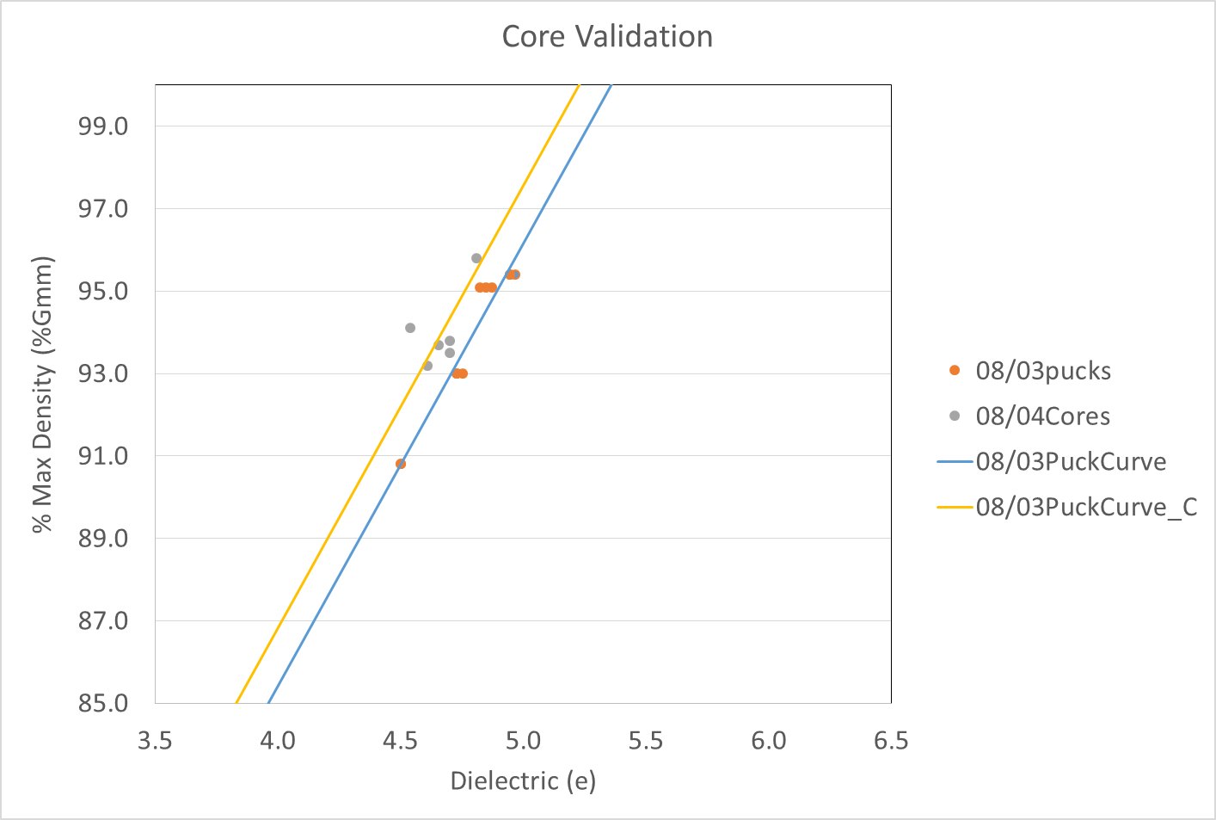

2020 Dielectric to Density: Core Accuracy Check
Some biased but good relationship e vs %Gmm

Slide 16
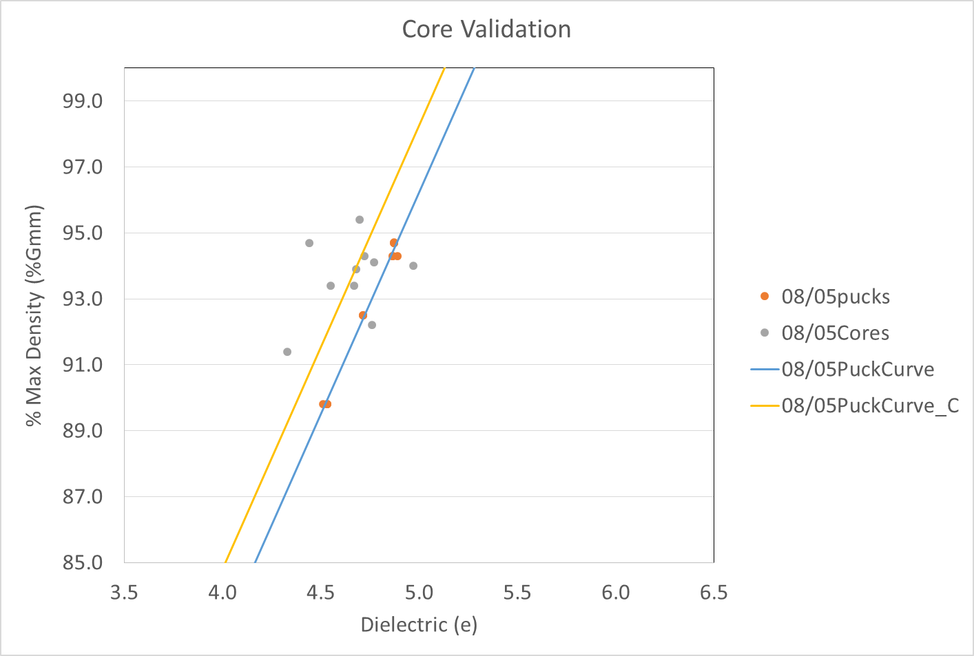
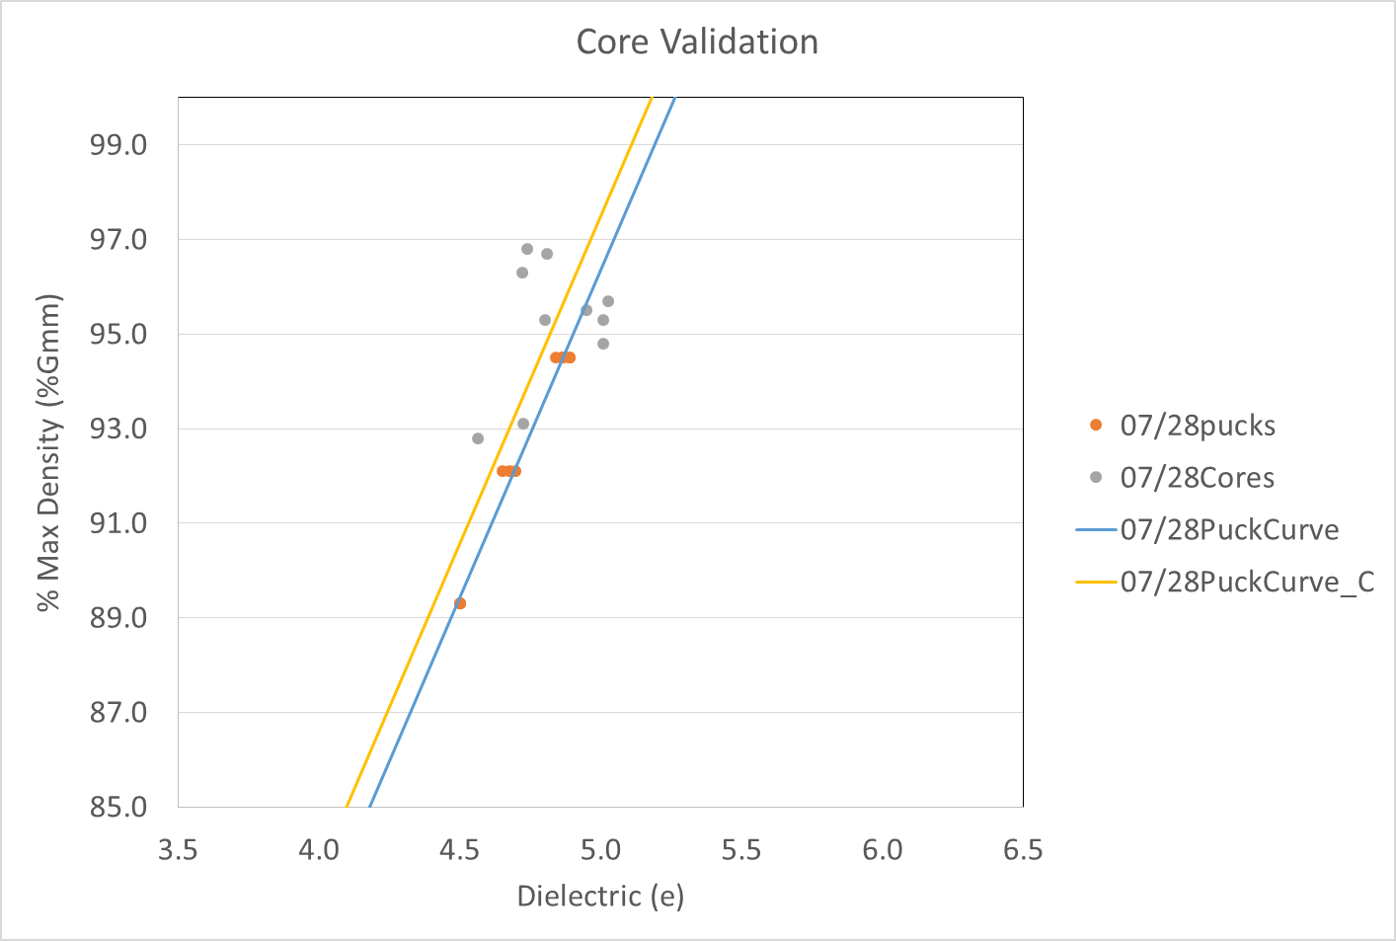
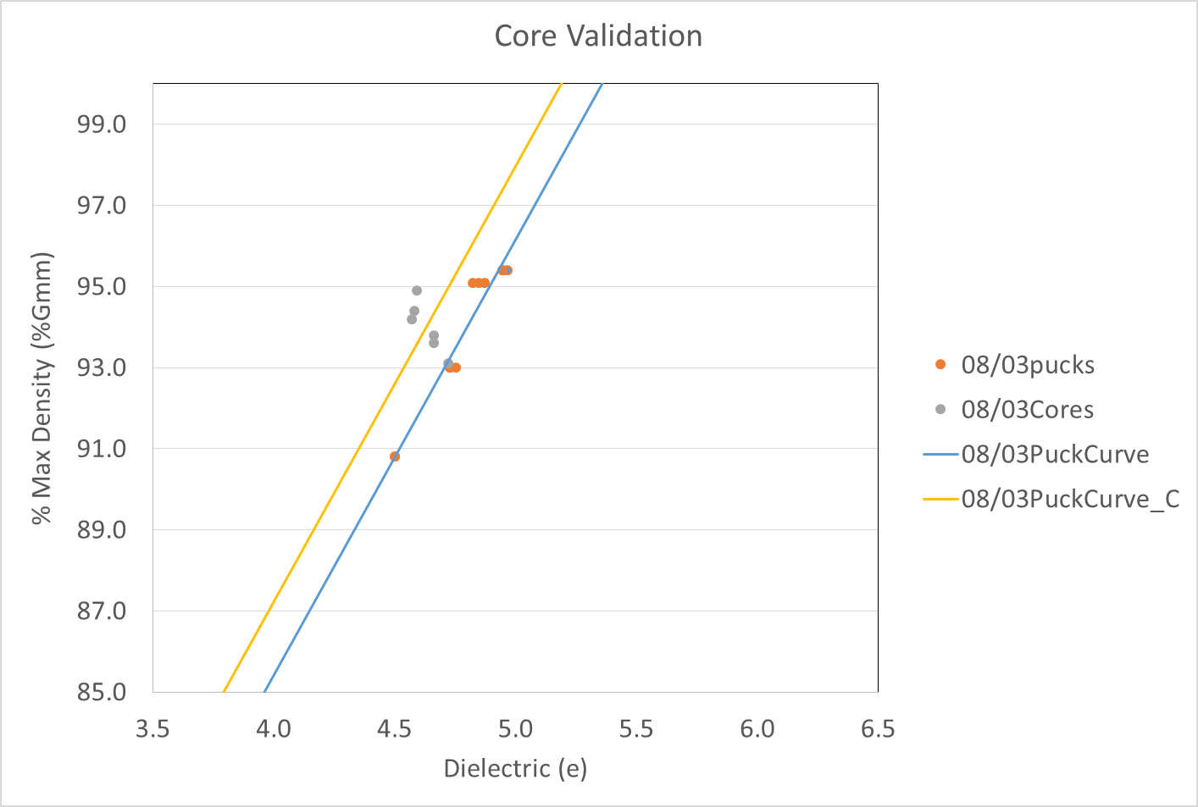
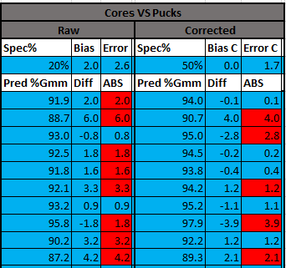
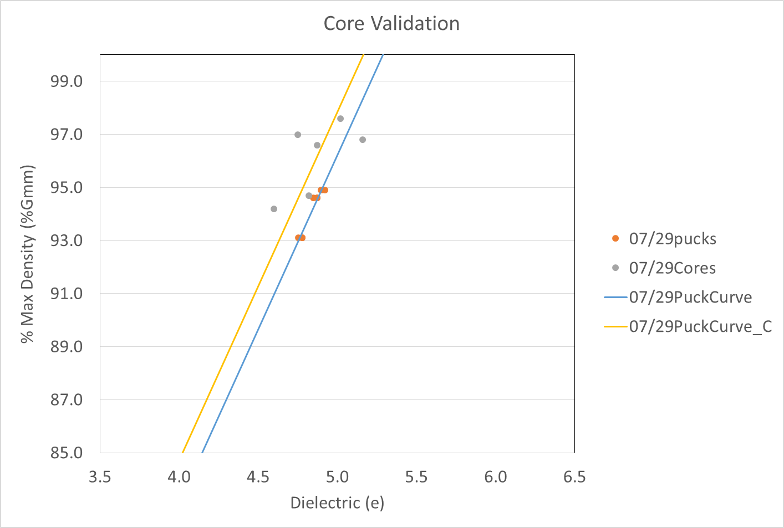
2020 Dielectric to Density: Core Accuracy Check
Some poor relationship

Slide 17
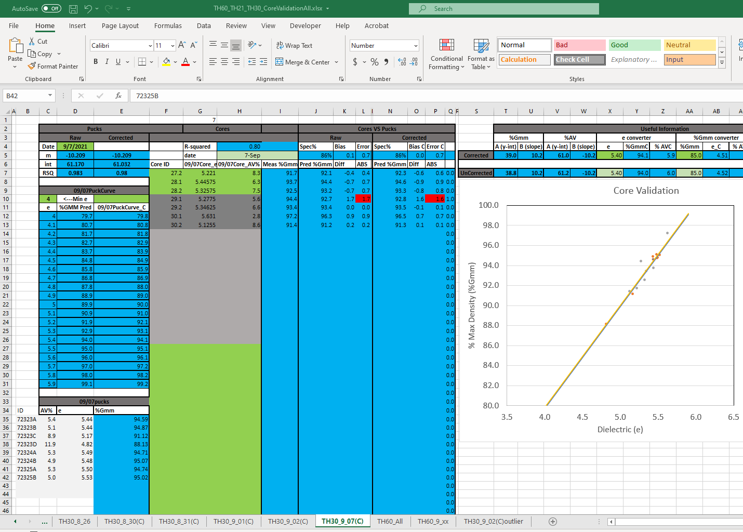
2021 Dielectric to Density: Core Accuracy Check
2021 Results: Continued last year’s trend of mostly good agreement:
  Click excel document here to go through details of the 2021 results

Slide 18
2021 Dielectric to Density: Bias Investigation
2021 Results: Still some worrisome days with bias between field and pucks
  Contacted GSSI with issue: Initial investigation has no “smoking gun” (shown here in next few slides)
  More detailed investigation with UNH contract
  Proposed technical working group meetings to attack challenges and get feedback on potential solutions

Slide 19
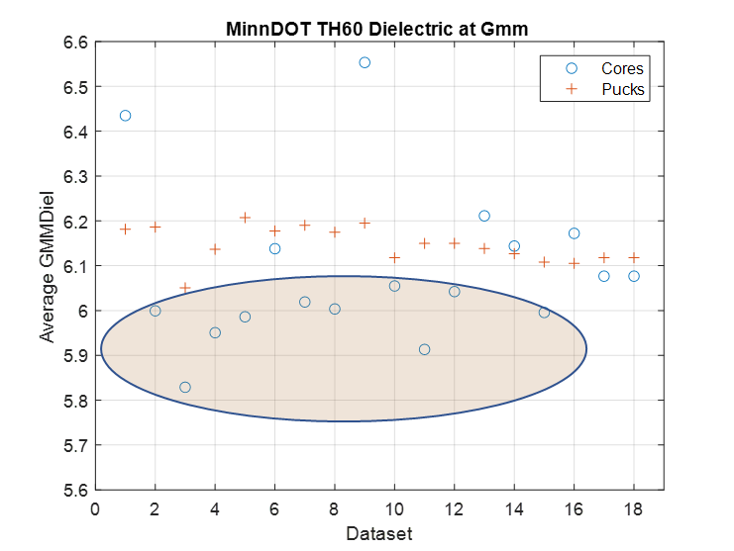
2021 Dielectric to Density: Bias Investigation
Plot of showing bias spanning a set of 18 paving days (dataset) from TH60 exhibiting the bias
  Nomalize cores and pucks to max density dielectric (calculated using mix model) and plotting confirms bias between cores and pucks.
Finding root cause of this bias is the goal of the investigation

Slide 20
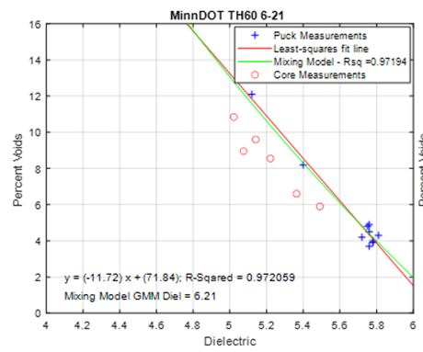
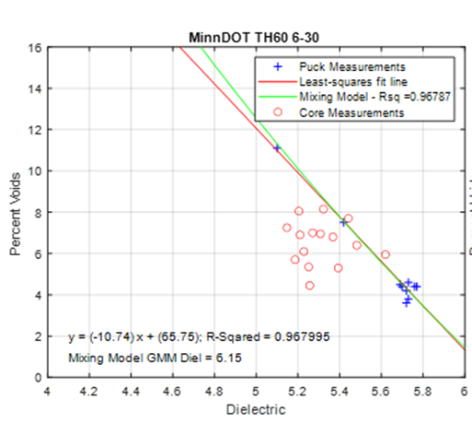
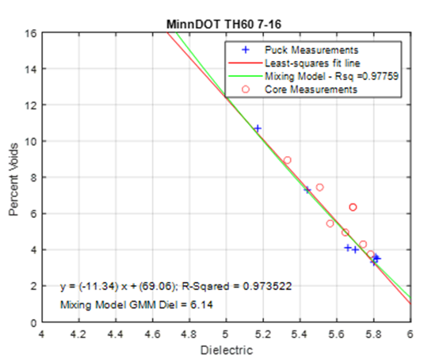
2021 Dielectric to Density: Bias Investigation
A sub-sample from 9 paving days was chosen. The sub-sample consists of 3 different observed scenarios:
  Good Agreement between cores and pucks (6-22, 6-29, 7-16)
  Core and puck calibrations appeared to be linearly offset (6-15, 6-18, 6-21)
  Core calibration shows no linear trend (6-17, 6-25, 6-30)

Slide 21

Initial evaluation of sources of bias
Need for calibration puck in lab
  RDM 2.0 kit has this
Bias between surface reflection dielectric (field) and velocity dielectric (lab)
  Use magnetic susceptibility meter
Moisture presence
  Use moisture gauge?
Use of Puck thickness that is consistently too high or low
  Thickness Gage shows no significant thickness error in Gyratory readout
  Some variability in high voids

Slide 22
Potential Sources of Error or Bias: Magnetic Susceptibility
Granite with Magnetic Susceptibility of 0.02 and dielectric of 5.5
Dielectric calculated by travel time = 5.5* (1.02) = 5.6
Dielectric calculated by surface reflection = 5.4

Slide 23
Potential Sources of Error or Bias: Magnetic Susceptibility
Material bias needs to be evaluated in two ways
  Magnetic susceptibility measurements need to be performed. A potential tool for this is the KT-10 magnetic susceptibility meter.
    Interestingly, the Gmm Dielectric of the TH60 pucks translates to an aggregate dielectric of over 7.0 using the mixing model. This high dielectric suggests that the aggregate may either be limestone or a granite with heavy metals, such as iron, which may provide some magnetic susceptibility.
    Magnetic susceptibility measurements on a sample of the TH60 pucks performed at UNH on 11/4/21 indicate no significant magnetic susceptibility.
    UNH has possession of pucks for additional testing

Slide 24



Initial evaluation of sources of bias
Need for calibration puck in lab
  RDM 2.0 kit has this
Bias between surface reflection dielectric (field) and velocity dielectric (lab)
  Use magnetic susceptibility meter
Moisture presence
  Use moisture gauge?
Use of Puck thickness that is consistently too high or low
  Thickness Gage shows no significant thickness error in Gyratory readout
  Some variability in high voids
DPS Moisture Test with Gann Meter and FLIR MR160 Meter

Slide 25

Initial evaluation of sources of bias
On 3 days there are calculated Percent voids less then -5%. This scenario corresponds to an anomalously high reflection amplitude that is often related to excessive moisture on the surface.

Slide 26

Initial evaluation of sources of bias
Need for calibration puck in lab
  RDM 2.0 kit has this
Bias between surface reflection dielectric (field) and velocity dielectric (lab)
  Use magnetic susceptibility meter
Moisture presence
  Use moisture gauge?
Use of Puck thickness that is consistently too high or low
  Thickness Gage shows no significant thickness error in Gyratory readout
  Some variability in high voids

Slide 27


Potential Sources of Error or Bias: Puck Thickness Sensitivity
Precise puck thickness equipment shows generally good agreement with gyratory readouts
  Saved one puck per day: 46 pucks
  Compared gyratory reading to puck thickness measurement

Slide 28

Initial evaluation of sources of bias
Effect of Temperature
  Sensor internal
  Pavement surface
  Puck temperature
  Heating history of the antenna from one day to the next
    Potential impact up to 0.1 difference in dielectric
    If antenna temperature calibration has changed since factory cal, this difference could be greater than 0.1
Using the approximation that a 1% change in amplitude translates to about a 1.2% change in voids, it is observed(left size) that the vast majority of the core measurements have a normalized amplitude that is 0.995 or greater. This means that any temperature correction applied to the measurements would modify the calculated % voids by about 0.6 or less.

Slide 29



Initial evaluation of sources of bias
Effect of Temperature
  Sensor internal
  Pavement surface
  Puck temperature
  Increase in dielectric per change in temperature approximately 0.1 dielectric per 100 degrees Fahrenheit
  Not significant enough to explain difference.

Slide 30


Initial evaluation of sources of bias
Effect of Temperature
  Sensor internal
  Pavement surface
  Puck temperature
  Increase in dielectric per change in temperature approximately 0.08 dielectric per 100 degrees Fahrenheit
  Not significant enough to explain difference.

Slide 31


Initial evaluation of sources of bias
Effect of Sensor Height: Highly variable if deviated from height at metal plate calibration
  Can be a change of over 0.1 dielectric for a 0.2 in. change in height.

Slide 32


Initial evaluation of sources of bias
Effect of Sensor Height
SN 303
SN 303
Comparisons between %Void differences and Metal plate calibration height (left) and height change between the metal plate and core measurements (right) reveal no suspicious trends.

Slide 33
Initial evaluation of sources of bias
Effect of Surface Texture: Potential Segregation?
To calculate the data plotted, only the distance-based core file data were used.
The standard deviation of the surface reflection amplitude from each scan is divided by the standard deviation of the direct coupling amplitudes. The averages from all the cores are plotted. Values greater than 1 imply surface texture/lateral variability in dielectrics. There are two anomalous days – day 1 and day 3.

Slide 34

Initial evaluation of sources of bias
Effect of Metal Calibration
  The calibration from Day 4 was used to process the data because the data from it had the lowest %Void difference. After reprocessing, the average %Voids difference decreased in all the other datasets. The decrease in %Void difference was substantial in Day 2 data. The decrease in %Void difference was not sufficient to entirely remove bias, but the median bias is decreased from 1.9% to 1.3%.
  Doesn’t explain shift.

Slide 35

Evaluation will continue with UNH and others. . .
Will look at other effects in addition to statistical analysis on data:
  Mix tested right out of truck for pucks, maybe sample behind paver?

Slide 36

Density Assessment – Finalized Defect Detection and “PWL (really percent conformance) Released
Email from GSSI last week (11/3):
The reason for this email is to provide you information about this update and some of its new features (reports) that can be very helpful to you.
Export Defects – This will export files (both .csv and .kml files) of user-defined defects only. This allows the user to have data of defects only and not have to scroll/filter/view/and whatever else you do through tons of data to find and process the defects
PWL Reports – This will export files for PWL information. Valid values are user-entered into the system, and reports are exports to show PWL information.

Slide 37


Density Assessment – Defect Detection
Typical analysis file by file
  Example with 2 sensors straddling the joint 0.75 ft. away and 2.25 ft from joint
  Good information just tough to navigate while on-site

Slide 38


Density Assessment – Defect Detection
Geospatial view

Slide 39

Density Assessment – “PWL” (Actually Percent Conformance)
Ability to define mat and joint acceptable density levels (min and max) and calculate percent conformance in user defined segments.
  MnDOT has been using other post processing tools like matlab and more recently VETA to make these types of calculations
  This is a simpler tool that can be run on-site and doesn’t require outside expertise (will show simple excel template to visualize it).

Slide 40



Density Assessment – “PWL” (Actually Percent Conformance)
Joint/Mat % conforming
Project Information:
Ex: 052221 TH21-HMA-L1-12L-CL
Lane Extents

Slide 41
Density Assessment – “PWL” (Actually Percent Conformance)
Example Data Organization/Analysis
using simple excel templates: TH21

Slide 42
Thank you again!
Kyle Hoegh
kyle.hoegh@state.mn.us
507-398-2669

Slide 43



Geospatial Filtering
Further Analysis needs
  Filter geospatially by offset?

